Slide 1
Financial Crisis 2008

Slide 2
The financial crisis of 2007–2008, also known as the global financial crisis and the 2008 financial crisis, is considered by many economists to have been the worst financial crisis since the Great Depression of the 1930s.
Housing Bubble Formation = Lending Decision by Financial institutions + Borrowing Decision by individuals.

Slide 3
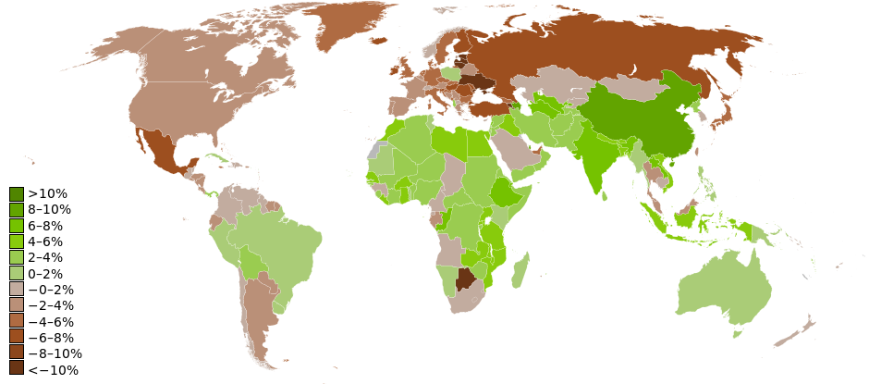
Global Impact

Slide 4
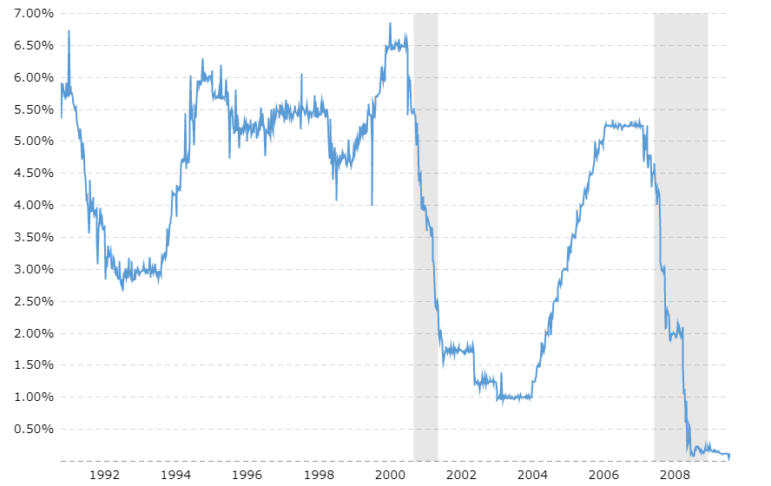
FED Interest rates
The Federal Reserve Board (FED) manages the nation’s monetary policy by controlling money flow in system & try to maintain stable economy.

Slide 5
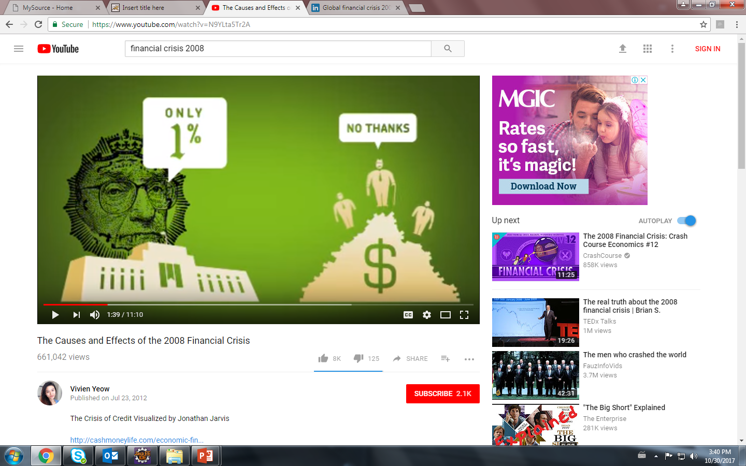
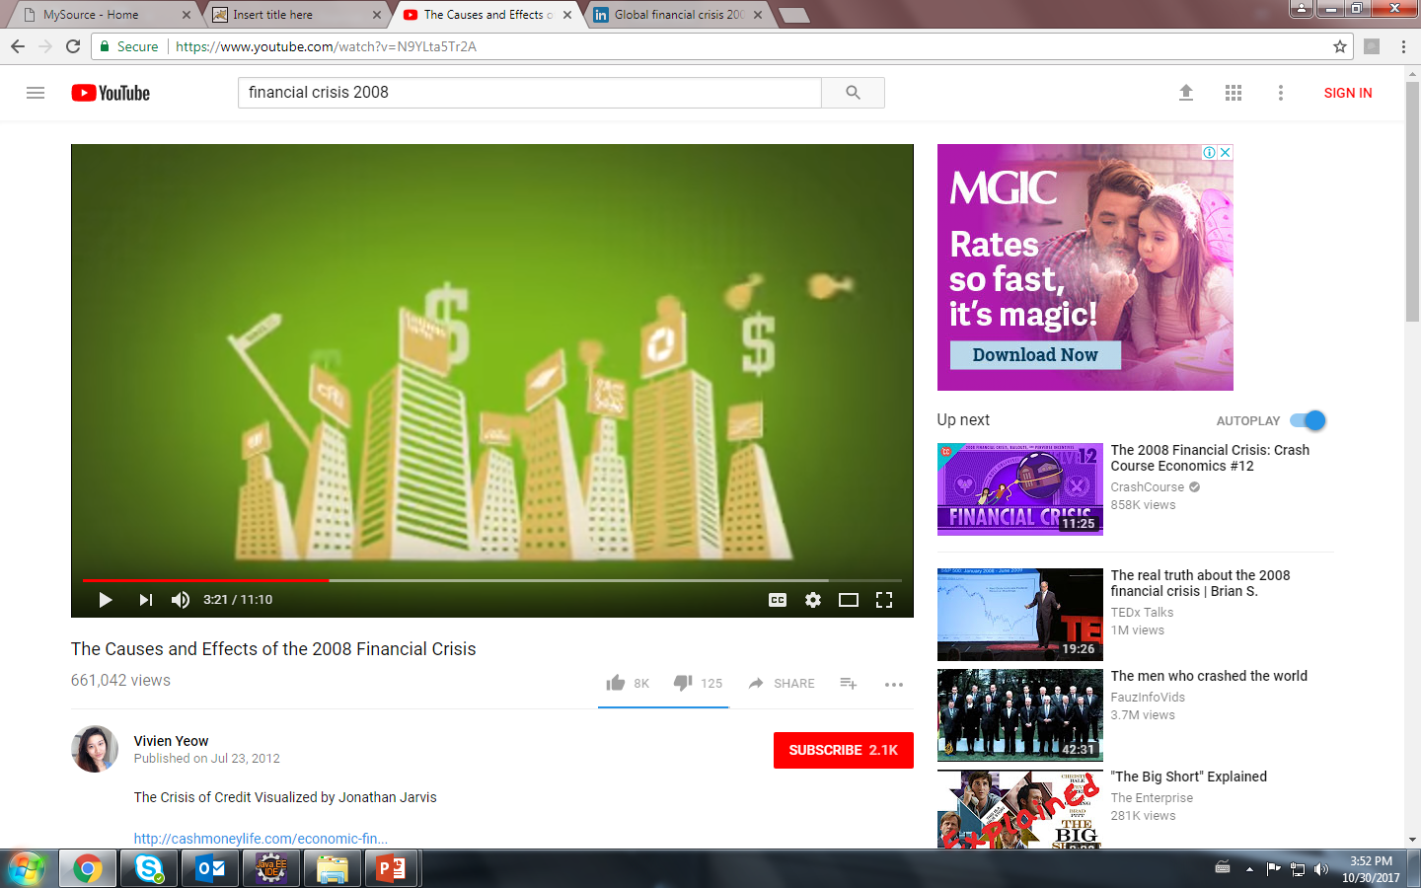
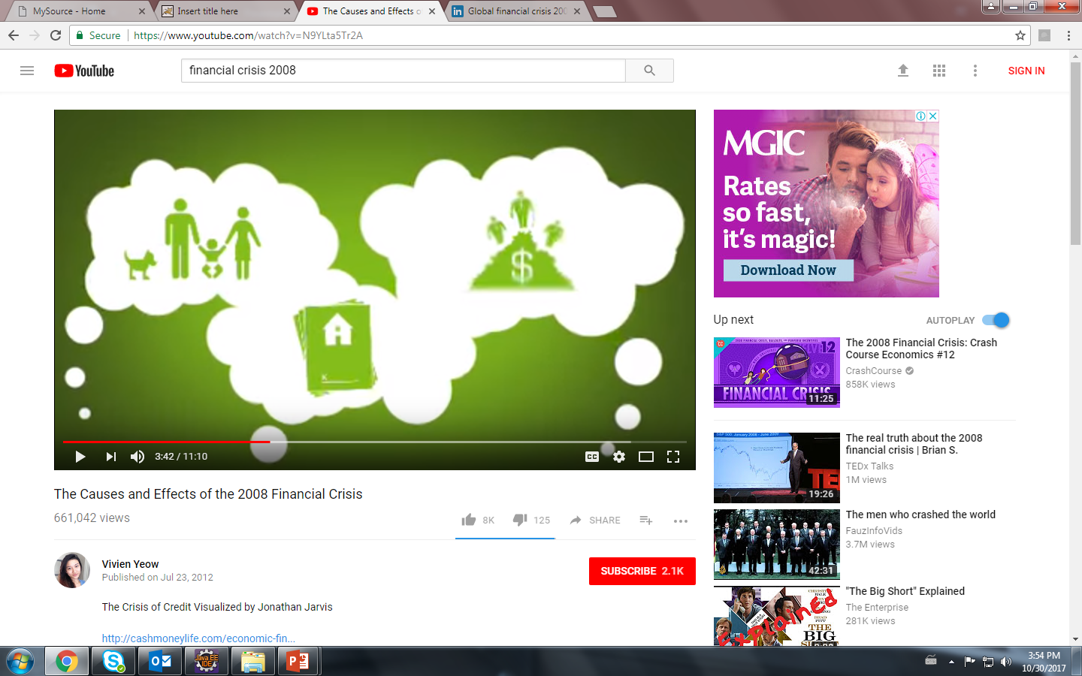

Slide 6
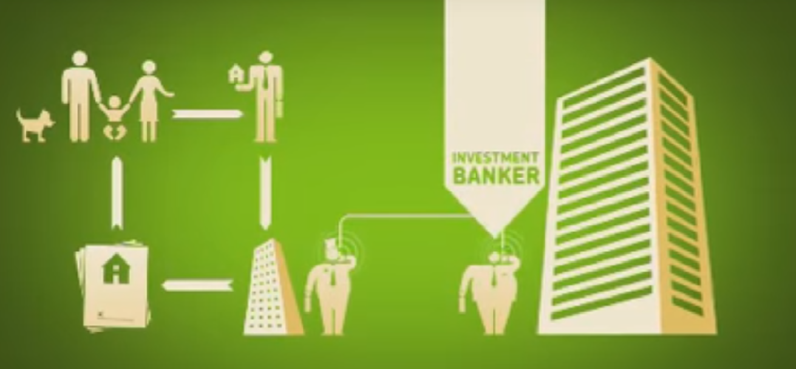
Mortgage home

Slide 7
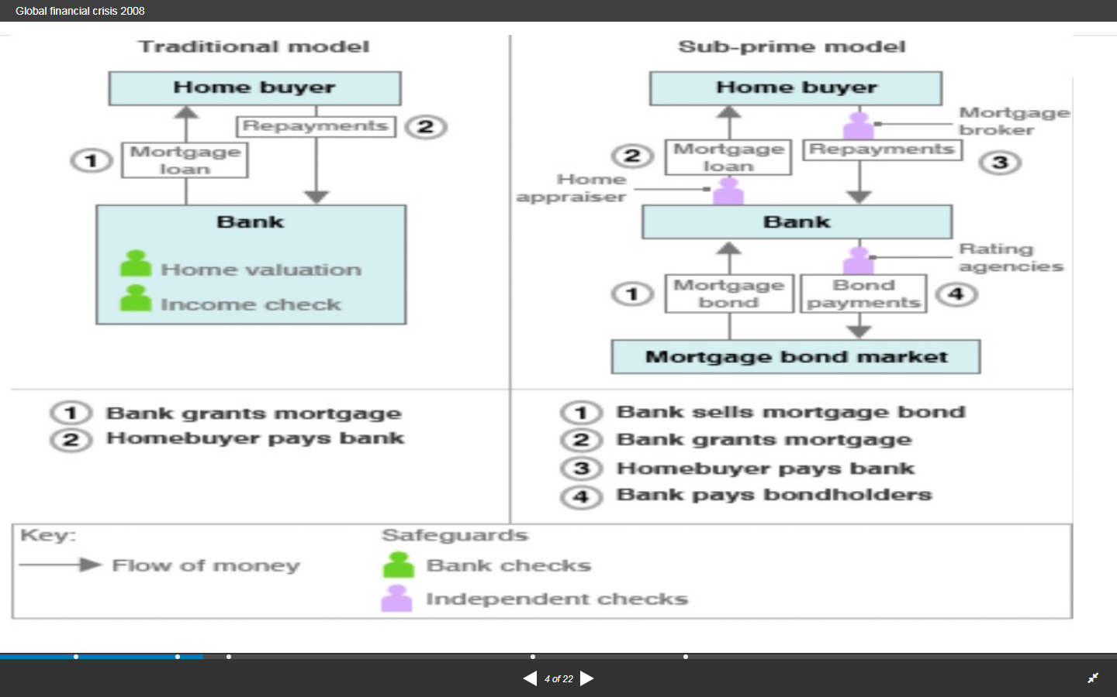

Slide 8
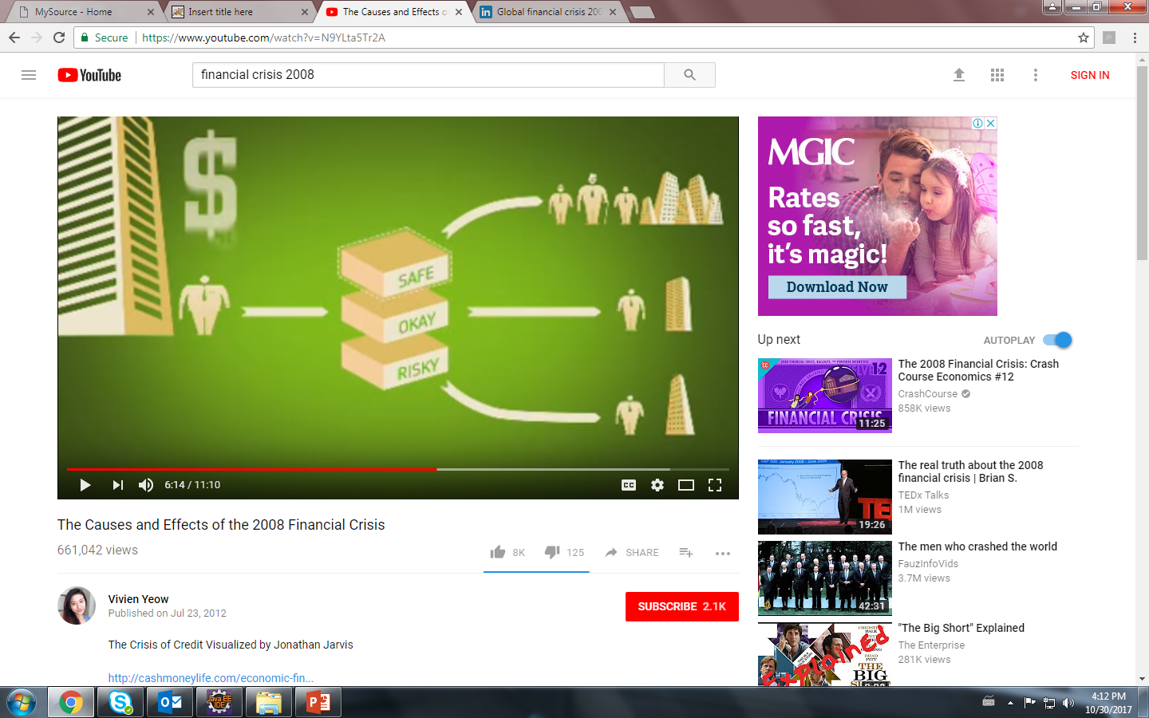
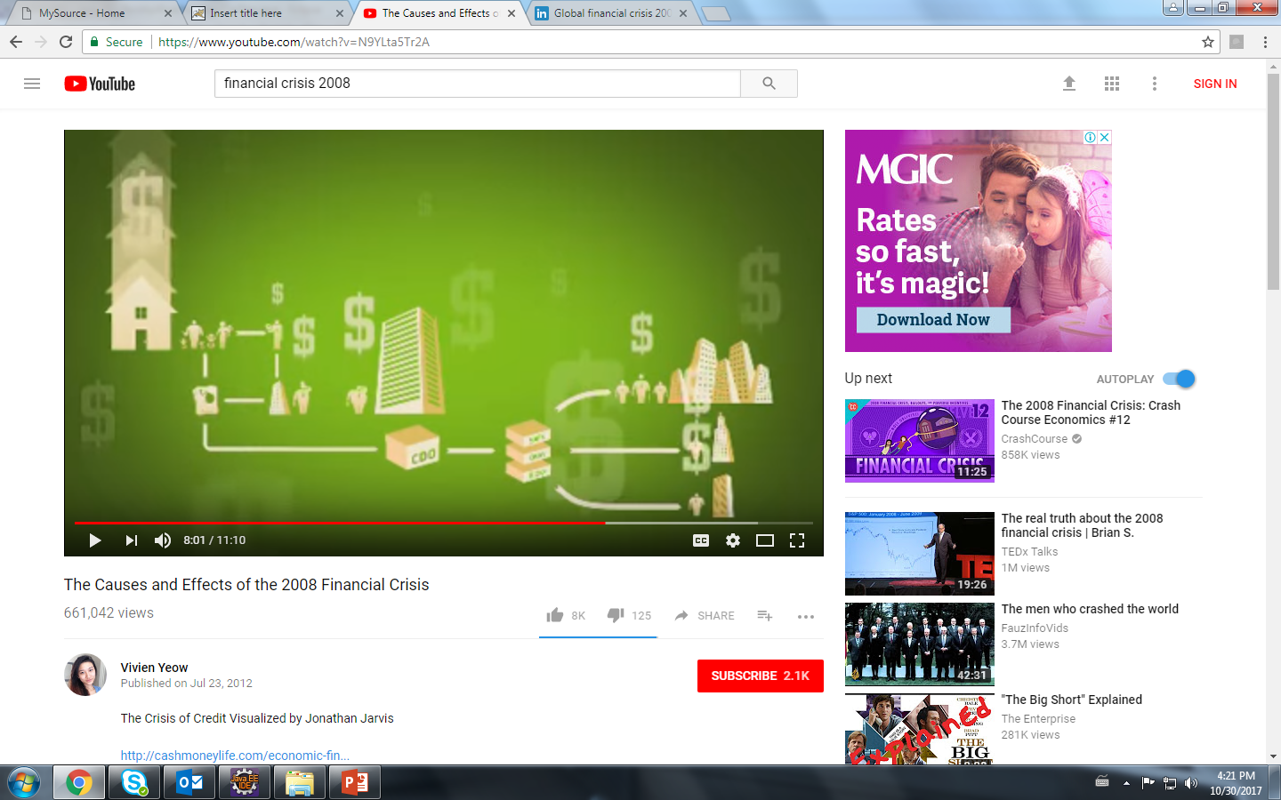
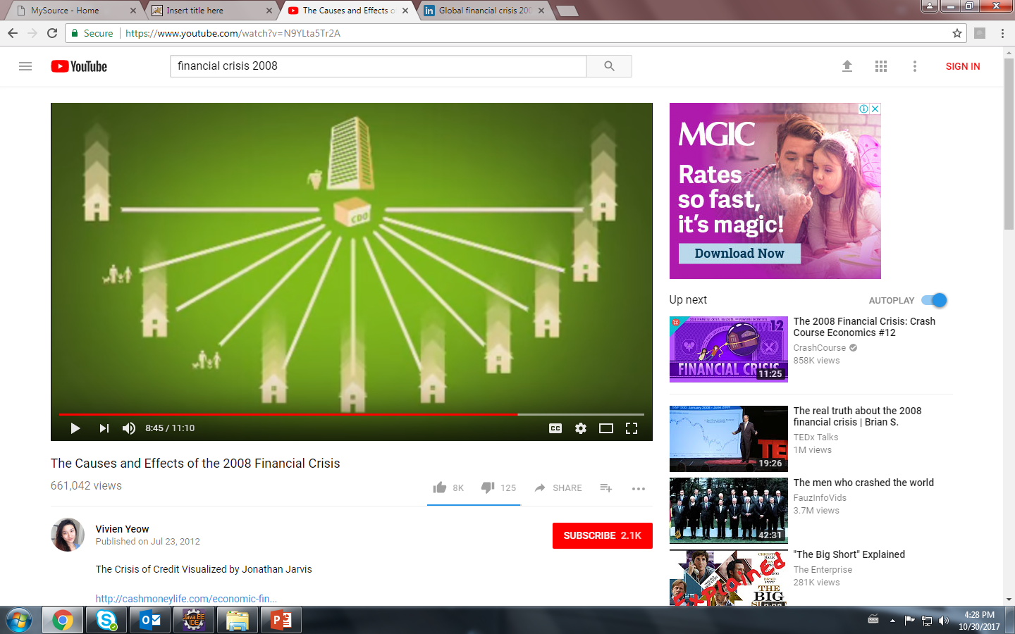
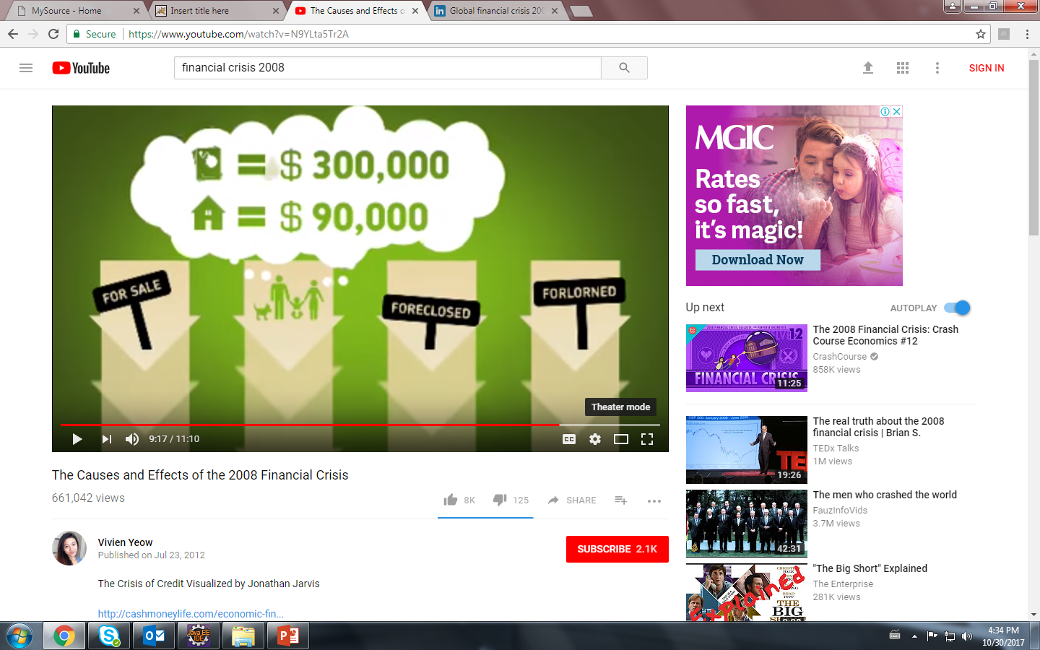

Slide 9
Causes of Crisis
Relaxation in lending regulations
Poor creditworthiness of borrowers
Rising EMI due to higher interest cost
Borrowers unable to pay
Failure of banks and financial institutions

Slide 10
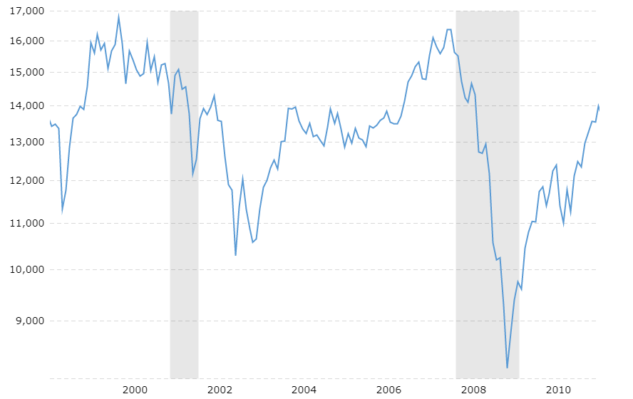
Dow Jones Price Change

Slide 11
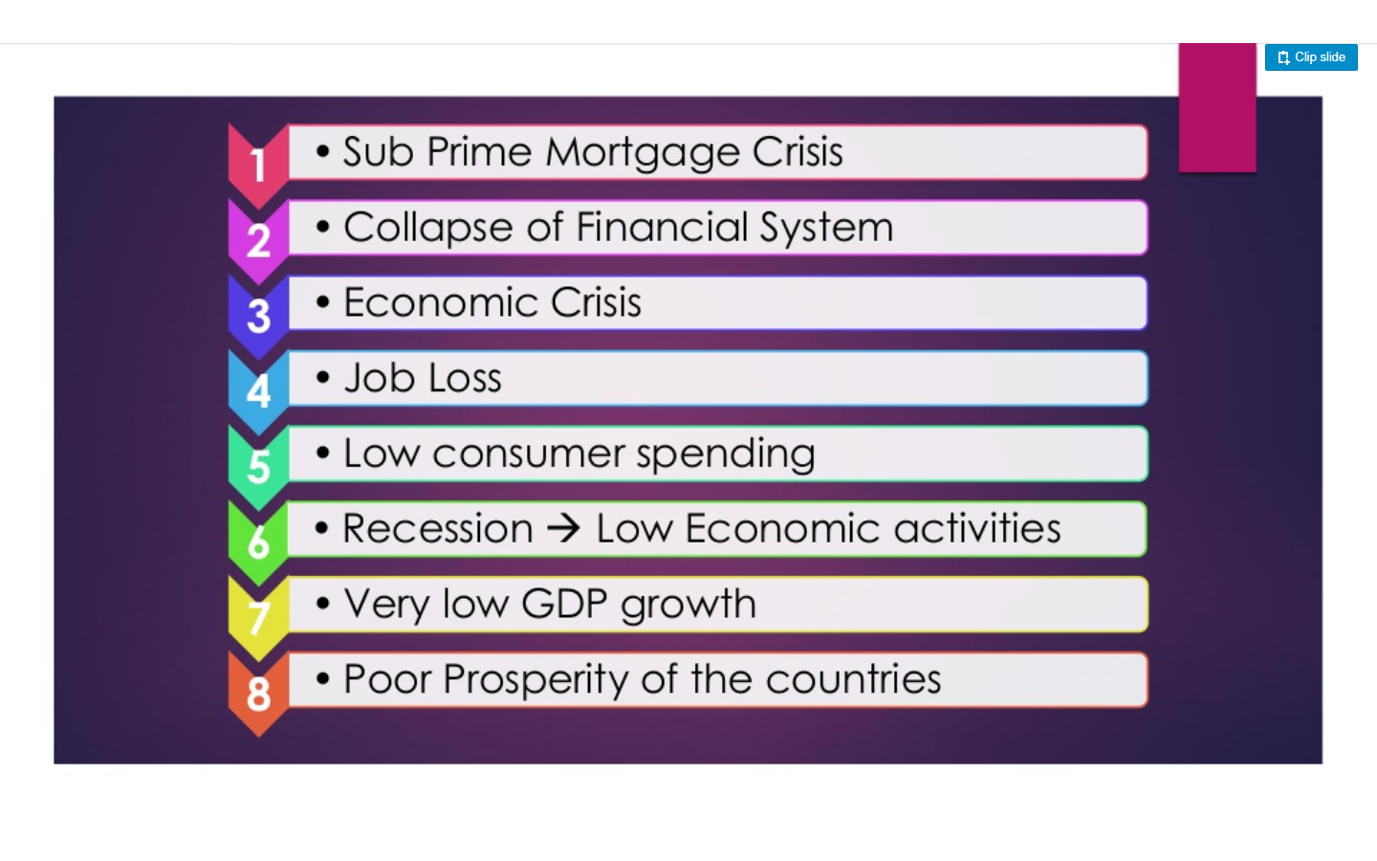
Impacts Of Crisis

Slide 12
Recession effects
GDP fell by 5.5%
In 2006-07 Unemployment rate was 5%. At the end of recession in 2009-10 unemployment rate was 10-10.5%.
Many banks went bankrupt like Lehman Brothers

Slide 13
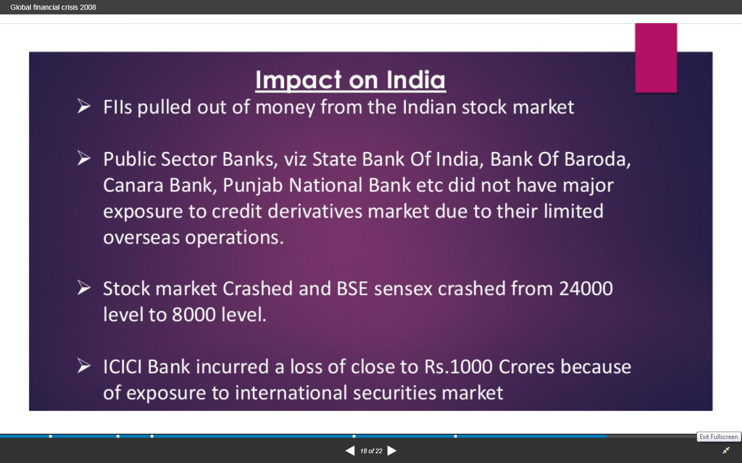
Impact on India

Slide 14
Thank You!

